Slide 1
Timer Programming

Slide 2
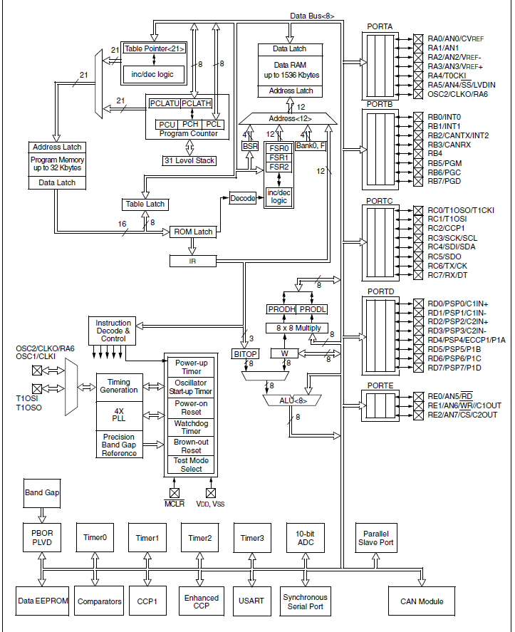

Slide 3
PIC18f458 has 4 timers – Timer 0, 1,2,3
A timer can be used to generate time delay (internal clock).
It can also be used as a counter (external clock).

Slide 4
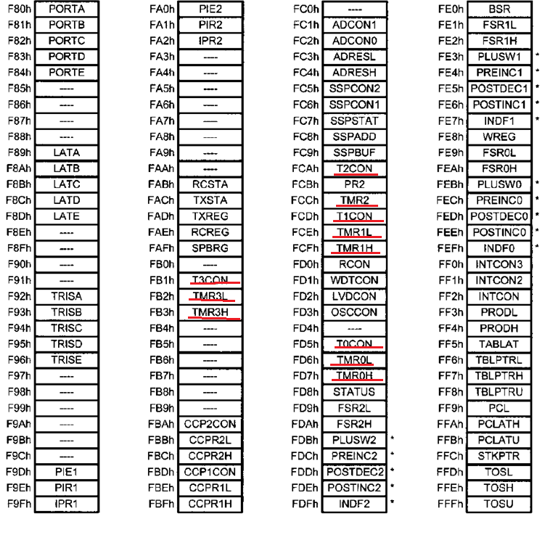

Slide 5
Timer Registers(16 bits)
TMRxH - TMRxL

Slide 6
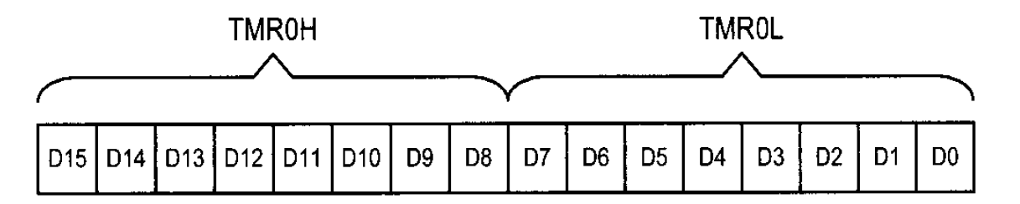
Timer Registers(16 bits)
TMRxH - TMRxL

Slide 7
Programming Timers 0 and 1

Slide 8
Timer Control Registers(8 bits)
TxCON

Slide 10
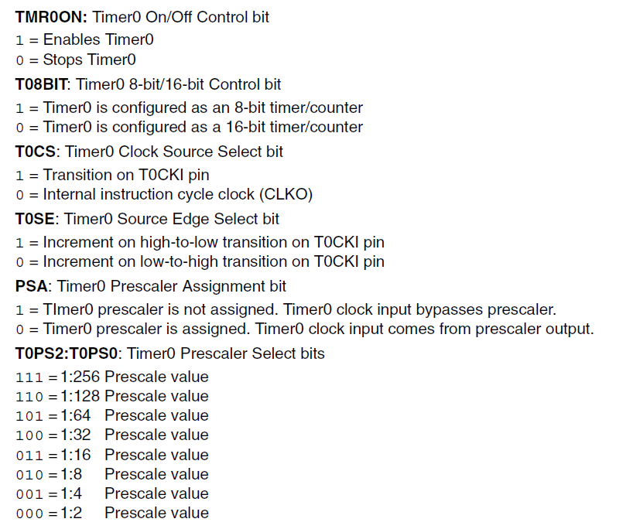

Slide 11
Fine the value for T0CON if we want to program Timer0 in 16-bit mode, no prescale. Use PIC18’s Fosc/4 crystal oscillator for the clock source, increment on positive edge.

Slide 12
Fine the value for T0CON if we want to program Timer0 in 16-bit mode, no prescale. Use PIC18’s Fosc/4 crystal oscillator for the clock source, increment on positive edge.

Slide 13
Fine the value for T0CON if we want to program Timer0 in 16-bit mode, no prescale. Use PIC18’s Fosc/4 crystal oscillator for the clock source, increment on positive edge.
Counter 16 bit transition increment Prescaler
timer off on cycle clock on +ve edge not assigned
low to high

Slide 14
Fine the value for T0CON if we want to program Timer0 in 16-bit mode, no prescale. Use PIC18’s Fosc/4 crystal oscillator for the clock source, increment on positive edge.
Counter 16 bit transition increment Prescaler
timer off on cycle clock on +ve edge not assigned
low to high
0 0 0 0 1 0 0 0

Slide 15
Fine the value for T0CON if we want to program Timer0 in 16-bit mode, no prescale. Use PIC18’s Fosc/4 crystal oscillator for the clock source, increment on positive edge.
Counter 16 bit transition increment Prescaler
timer off on cycle clock on +ve edge not assigned
low to high
0 0 0 0 1 0 0 0
T0CON = 00001000 = 0x08

Slide 16
Find the timer’s clock frequency and its period for PIC18, with the following crystal frequencies. Assume no prescaler is used.
10 MHz
16 MHz
4 MHz

Slide 17
Clock frequency = crystal frequency / 4
Period or time = 1/clock frequency

Slide 19
16 bit Timer programming
TMR0H-TMR0L – 0000H to FFFFH
Start the timer0
Set the timer on bit
BSF T0CON, TMR0ON or BSF T0CON,7
It starts to count up till FFFFH then back to 0000H.
When it reaches FFFFH, timer interrupt flag (TMR0IF ) of interrupt control register (INTCON) is set.
In order to repeat the process, load the TMR0H-TMR0L registers with the original value and reset TMR0IF.

Slide 20
Load TMR0H first and then TMR0L.
Then set TMR0ON bit.

Slide 21
Load TMR0H first and then TMR0L.
Then set TMR0ON bit.
When the instruction to load TMR0H is executed, the value will be copied in a temporary register and after loading TMR0L, it is copied from temporary register to TMR0H.

Slide 22
Load TMR0H first and then TMR0L.
Then set TMR0ON bit.
When the instruction to load TMR0H is executed, the value will be copied in a temporary register and after loading TMR0L, it is copied from temporary register to TMR0H.
i.e. when TMR0L is loaded, whatever is there in the temporary register, gets copied to TMR0H, and if TMR0ON bit is set, counting may start with a wrong value.

Slide 23
Write a program to generate a square wave of 50% duty cycle on PORTB.5 bit. Use Timer0 to generate the time delay

Slide 24
Algorithm:
Set 5th bit of port B for output
Calculate the value of T0CON register and assign to it
Load TMR0H and TMR0L registers (ex. FF00H)
Clear timer interrupt flag bit
Toggle 5th bit of Port B
Start timer0 by setting the TMR0ON bit
Keep watching timer interrupt flag bit
When it is set, stop timer0
Go to step 3.

Slide 25
Counter 16 bit transition increment Prescaler
timer off on cycle clock on +ve edge not assigned
low to high
0 0 0 0 1 0 0 0
T0CON = 00001000 = 0x08

Slide 26
Algorithm:
Set 5th bit of port B for output
Calculate the value of T0CON register and assign to it
Load TMR0H and TMR0L registers (ex. FF00H)
Clear timer interrupt flag bit
Toggle 5th bit of Port B
Start timer0 by setting the TMR0ON bit
Keep watching timer interrupt flag bit
When it is set, stop timer0
Go to step 3.
Program:
BCF TRISB,5

Slide 27
Algorithm:
Set 5th bit of port B for output
Calculate the value of T0CON register and assign to it
Load TMR0H and TMR0L registers (ex. FF00H)
Clear timer interrupt flag bit
Toggle 5th bit of Port B
Start timer0 by setting the TMR0ON bit
Keep watching timer interrupt flag bit
When it is set, stop timer0
Go to step 3.
Program:
BCF TRISB,5
MOVLW 0x08
MOVF T0CON

Slide 28
Algorithm:
Set 5th bit of port B for output
Calculate the value of T0CON register and assign to it
Load TMR0H and TMR0L registers (ex. FF00H)
Clear timer interrupt flag bit
Toggle 5th bit of Port B
Start timer0 by setting the TMR0ON bit
Keep watching timer interrupt flag bit
When it is set, stop timer0
Go to step 3.
Program:
BCF TRISB,5
MOVLW 0x08
MOVF T0CON
MOVLW 0xFF
MOVF TMR0H
MOVLW 0
MOVF TMR0L

Slide 29
Algorithm:
Set 5th bit of port B for output
Calculate the value of T0CON register and assign to it
Load TMR0H and TMR0L registers (ex. FF00H)
Clear timer interrupt flag bit
Toggle 5th bit of Port B
Start timer0 by setting the TMR0ON bit
Keep watching timer interrupt flag bit
When it is set, stop timer0
Go to step 3.
Program:
BCF TRISB,5
MOVLW 0x08
MOVF T0CON
MOVLW 0xFF
MOVF TMR0H
MOVLW 0
MOVF TMR0L
BCF INTCON, TMR0IF

Slide 30
Algorithm:
Set 5th bit of port B for output
Calculate the value of T0CON register and assign to it
Load TMR0H and TMR0L registers (ex. FF00H)
Clear timer interrupt flag bit
Toggle 5th bit of Port B
Start timer0 by setting the TMR0ON bit
Keep watching timer interrupt flag bit
When it is set, stop timer0
Go to step 3.
Program:
BCF TRISB,5
MOVLW 0x08
MOVF T0CON
MOVLW 0xFF
MOVF TMR0H
MOVLW 0
MOVF TMR0L
BCF INTCON, TMR0IF
BTG PORTB, 5

Slide 31
Algorithm:
Set 5th bit of port B for output
Calculate the value of T0CON register and assign to it
Load TMR0H and TMR0L registers (ex. FF00H)
Clear timer interrupt flag bit
Toggle 5th bit of Port B
Start timer0 by setting the TMR0ON bit
Keep watching timer interrupt flag bit
When it is set, stop timer0
Go to step 3.
Program:
BCF TRISB,5
MOVLW 0x08
MOVF T0CON
MOVLW 0xFF
MOVF TMR0H
MOVLW 0
MOVF TMR0L
BCF INTCON, TMR0IF
BTG PORTB, 5
BSF T0CON, TMR0ON

Slide 32
Algorithm:
Set 5th bit of port B for output
Calculate the value of T0CON register and assign to it
Load TMR0H and TMR0L registers (ex. FF00H)
Clear timer interrupt flag bit
Toggle 5th bit of Port B
Start timer0 by setting the TMR0ON bit
Keep watching timer interrupt flag bit
When it is set, stop timer0
Go to step 3.
Program:
BCF TRISB,5
MOVLW 0x08
MOVF T0CON
MOVLW 0xFF
MOVF TMR0H
MOVLW 0
MOVF TMR0L
BCF INTCON, TMR0IF
BTG PORTB, 5
BSF T0CON , TMR0ON
L2 BTFSS INTCON, TMR0IF
GOTO L2

Slide 33
Algorithm:
Set 5th bit of port B for output
Calculate the value of T0CON register and assign to it
Load TMR0H and TMR0L registers (ex. FF00H)
Clear timer interrupt flag bit
Toggle 5th bit of Port B
Start timer0 by setting the TMR0ON bit
Keep watching timer interrupt flag bit
When it is set, stop timer0
Go to step 3.
Program:
BCF TRISB,5
MOVLW 0x08
MOVF T0CON
MOVLW 0xFF
MOVF TMR0H
MOVLW 0
MOVF TMR0L
BCF INTCON, TMR0IF
BTG PORTB, 5
BSF T0CON , TMR0ON
L2 BTFSS INTCON, TMR0IF
GOTO L2
BCF T0CON, TMR0ON

Slide 34
Algorithm:
Set 5th bit of port B for output
Calculate the value of T0CON register and assign to it
Load TMR0H and TMR0L registers (ex. FF00H)
Clear timer interrupt flag bit
Toggle 5th bit of Port B
Start timer0 by setting the TMR0ON bit
Keep watching timer interrupt flag bit
When it is set, stop timer0
Go to step 3.
Program:
BCF TRISB,5
MOVLW 0x08
MOVF T0CON
L1 MOVLW 0xFF
MOVF TMR0H
MOVLW 0
MOVF TMR0L
BCF INTCON, TMR0IF
BTG PORTB, 5
BSF T0CON , TMR0ON
L2 BTFSS INTCON, TMR0IF
GOTO L2
BCF T0CON, TMR0ON
GOTO L1

Slide 35
Algorithm:
Set 5th bit of port B for output
Calculate the value of T0CON register and assign to it
Load TMR0H and TMR0L registers (ex. FF00H)
Clear timer interrupt flag bit
Toggle 5th bit of Port B
Start timer0 by setting the TMR0ON bit
Keep watching timer interrupt flag bit
When it is set, stop timer0
Go to step 3.
Program:
BCF TRISB,5
MOVLW 0x08
MOVF T0CON
L1 MOVLW 0xFF
MOVF TMR0H
MOVLW 0
MOVF TMR0L
BCF INTCON, TMR0IF
BTG PORTB, 5
BSF T0CON , TMR0ON
L2 BTFSS INTCON, TMR0IF
GOTO L2
BCF T0CON, TMR0ON
GOTO L1

Slide 36
What is the amount of time delay generated by the timer in the previous example. Assume that XTAL = 10MHz.

Slide 37
What is the amount of time delay generated by the timer in the previous example. Assume that XTAL = 10MHz.
Timer frequency = crystal frequency/4 = 10/4 = 2.5MHz.
Each clock period = T = 1/2.5MHz = 0.4µs
Time delay= number of counts * clock period
Number of counts = FFFFH – FF00H +1(rolling back) = 100H (256 decimal)
Time delay(half cycle) = 256 * 0.4 = 102.4 µs
Time delay(full cycle) = 102.4 * 2 = 204.8 µs

Slide 38
What is the frequency of the square wave generated by the following program at PORTB.5. Consider the delay generated by the execution of the instructions also.

Slide 39
BCF TRISB, 5
MOVLW 0x08
MOVF T0CON
BCF INTCON, TMR0IF
L1 MOVLW 0xFF
MOVF TMR0H
MOVLW -D’48’
MOVWF TMR0L
CALL DELAY
BTG PORTB, 5
BRA L1
DELAY BSF T0CON, TMR0ON
L2 BTFSS, INTCON, TMR0IF
BRA L2
BCF T0CON, TMR0ON
BCF INTCON, TMR0IF
RETURN

Slide 40
BCF TRISB, 5
MOVLW 0x08
MOVF T0CON
BCF INTCON, TMR0IF
L1 MOVLW 0xFF
MOVF TMR0H
MOVLW -D’48’ ➔ Number of counts = FFFFH – (-48D)+1
MOVWF TMR0L
CALL DELAY
BTG PORTB, 5
BRA L1
DELAY BSF T0CON, TMR0ON
L2 BTFSS, INTCON, TMR0IF
BRA L2
BSF T0CON, TMR0ON
BCF INTCON, TMR0IF
RETURN

Slide 41
-48D = 2’s complement of 48
= 2’s complement of 0030H
= 2’s complement of 0000 0000 0011 0000 B
=1111 1111 1101 0000 B
=FFD0H

Slide 42
BCF TRISB, 5
MOVLW 0x08
MOVF T0CON
BCF INTCON, TMR0IF
L1 MOVLW 0xFF
MOVF TMR0H
MOVLW -D’48’ ➔ N0. of counts = FFFFH – FFD0H = 002FH +1 = 0030H =48D
MOVWF TMR0L
CALL DELAY
BTG PORTB, 5
BRA L1
DELAY BSF T0CON, TMR0ON
L2 BTFSS, INTCON, TMR0IF
BRA L2
BSF T0CON, TMR0ON
BCF INTCON, TMR0IF
RETURN

Slide 43
BCF TRISB, 5
MOVLW 0x08
MOVF T0CON
BCF INTCON, TMR0IF
L1 MOVLW 0xFF →1
MOVF TMR0H →1
MOVLW -D’48’ →1
MOVWF TMR0L →1
CALL DELAY →2
BTG PORTB, 5 →1
BRA L1 →2
DELAY BSF T0CON, TMR0ON →1
L2 BTFSS, INTCON, TMR0IF
BRA L2
BSF T0CON, TMR0ON →1
BCF INTCON, TMR0IF →1
RETURN →1
Total number of cycles = 48+13 = 61
Included in timer delay (48 cycles)

Slide 44
Total number of cycles = 48+13 = 61
Time delay of one full cycle = 61 * 0.4 * 2 = 48.8 µs
Frequency of the square wave = 1/48.8 = 20.491 KHz

Slide 45
Find the delay generated by timer0 in the following code. Do not include the overhead due to instructions. Assume XTAL = 10 MHz.

Slide 46
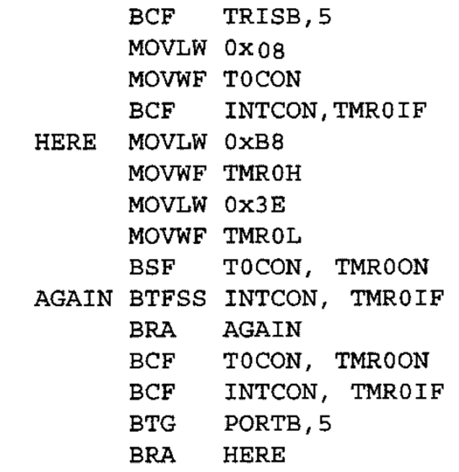

Slide 47
Timer frequency = crystal frequency/4 = 10/4 = 2.5MHz.
Each clock period = T = 1/2.5MHz = 0.4µs
Time delay= number of counts * clock period
Number of counts = FFFFH – B83EH +1(rolling back)
= 47C2H (18370 decimal)
Time delay(half cycle) = 18370 * 0.4 = 7348 µs = 7.348 ms

Slide 48
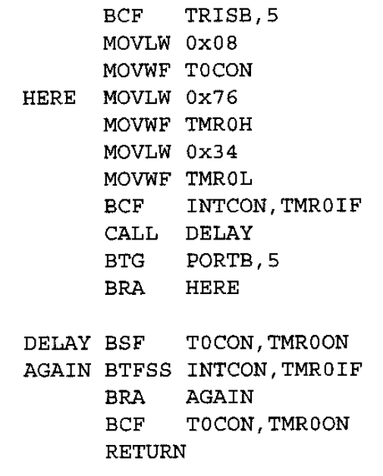

Slide 49
Timer frequency = crystal frequency/4 = 10/4 = 2.5MHz.
Each clock period = T = 1/2.5MHz = 0.4µs
Time delay= number of counts * clock period
Number of counts = FFFFH – 7634H +1(rolling back)
= 89CCH (35276 decimal)
Time delay(half cycle) = 35276 * 0.4 = 14110.4 µs = 14.1104 ms
Time delay(full cycle) = 14.1104*2 = 28.2208 ms
Frequency of square wave = 1/Time of full cycle = 35.4348 Hz

Slide 50
Given a time delay, procedure to calculate the values to be loaded in timer register

Slide 51
Given a time delay, procedure to calculate the values to be loaded in timer register
Assume that there is no prescaler
Let t be the time delay to be generated (in µs).
Let f be the crystal frequency (in MHz)

Slide 52
Steps
Calculate n = t*f/4
Calculate c= 65536 – n (FFFFH – n + 1)
Convert c to Hex, let it be pqrs.
Set TMR0H= pq and TMR0L = rs

Slide 53
Write a program to generate a square wave on PORTB.5 with a frequency of 35.4348 Hz. Assume that XTAL= 10 MHz

Slide 54
Write a program to generate a square wave on PORTB.5 with a frequency of 35.4348 Hz. Assume that XTAL= 10 MHz
Calculate n = t*f /4
Calculate c= 65536 – n (FFFFH – n + 1)
Convert c to Hex
Set TMR0H and TMR0L

Slide 55
Write a program to generate a square wave on PORTB.5 with a frequency of 35.4348 Hz. Assume that XTAL= 10 MHz
t = 1/(2*freq. of square wave)
= 1/(2*35.4348)
= 0.0141104 s = 14110.4 µs
Calculate n = t*f/4
Calculate c= 65536 – n (FFFFH – n + 1)
Convert c to Hex
Set TMR0H and TMR0L

Slide 56
Write a program to generate a square wave on PORTB.5 with a frequency of 35.4348 Hz. Assume that XTAL= 10 MHz
t = 1/(2*freq. of square wave)
= 1/(2*35.4348)
= 0.0141104 s = 14110.4 µs
Calculate n = t*f/4 ➔ n= 14110.4 * 10 /4 = 35276
Calculate c= 65536 – n (FFFFH – n + 1) = 65536 – 35276 = 30260
Convert c to Hex ➔ 7634H
Set TMR0H= 76H and TMR0L = 34H

Slide 57
Example
Assuming that XTAL = 10 MHz, write a program to generate a square wave with a period of 10 ms on pin PORTB.3

Slide 58
Example
Assuming that XTAL = 10 MHz, write a program to generate a square wave with a period of 10 ms on pin PORTB.3
Period = 10 ms
Time delay t = Period / 2 = 5 ms = 5000 µs
f = 10

Slide 59
Example
Assuming that XTAL = 10 MHz, write a program to generate a square wave with a period of 10 ms on pin PORTB.3
Period = 10 ms
Time delay t = Period / 2 = 5 ms = 5000 µs
f = 10
Calculate n = t*f/4
Calculate c= 65536 – n (FFFFH – n + 1)
Convert c to Hex
Set TMR0H and TMR0L

Slide 60
Example
Assuming that XTAL = 10 MHz, write a program to generate a square wave with a period of 10 ms on pin PORTB.3
Period = 10 ms
Time delay t = Period / 2 = 5 ms = 5000 µs
f = 10
Calculate n = t*f/4 ➔ n = 5000 * 10 / 4 = 12500
Calculate c= 65536 – n (FFFFH – n + 1) ➔ c= 65536-12500 = 53036
Convert c to Hex ➔ CF2CH
Set TMR0H = CFH and TMR0L = 2CH

Slide 61
Assuming that XTAL = 10 MHz, write a program to generate a square wave of 2 KHz frequency on pin PORTB.3

Slide 62
Assuming that XTAL = 10 MHz, write a program to generate a square wave of 2 KHz frequency on pin PORTB.3
t = 1/(2*freq. of square wave)
= 1/(2* 2 * 1000)
= 0.00025 s = 250 µs
Calculate n = t*f/4
Calculate c= 65536 – n (FFFFH – n + 1)
Convert c to Hex
Set TMR0H and TMR0L

Slide 63
Assuming that XTAL = 10 MHz, write a program to generate a square wave of 2 KHz frequency on pin PORTB.3
t = 1/(2*freq. of square wave)
= 1/(2* 2 * 1000)
= 0.00025 s = 250 µs
Calculate n = t*f/4 = 250 * 10 / 4 = 625
Calculate c= 65536 – 625 (FFFFH – n + 1) = 64911
Convert c to Hex ➔ FD8FH
Set TMR0H = FDH and TMR0L = 8FH

Slide 64
What is the largest possible delay and smallest frequency generated using timer0, assume XTAL = 10 MHz.

Slide 65
Maximum delay is generated when the timer counts from 0 to FFFFH.
i.e. TMR0H = TMR0L = 00.

Slide 66
For maximum delay prescalar 256 should be used
Timer frequency = crystal frequency/(4*256) = 10/(4*256) = 9.765MHz.
Each clock period = T = 1/9.765MHz = 0.1024µs
Time delay= number of counts * clock period
Number of counts = FFFFH – 0 +1(rolling back)
= 10000H (65536 decimal)
Largest Time delay(half cycle) = 65536* 0.1024 = 6710.8 µs = 6.7108 ms
Time delay(full cycle) = 6.7108*2 = 13.4216 ms
Smallest Frequency of square wave = 1/Time of full cycle = 74.506 Hz

Slide 67
What is the smallest possible delay and largest frequency generated using timer0, assume XTAL = 10 MHz.

Slide 68
Minimum delay is generated when the timer counts from FFFFH to 0000.
i.e. TMR0H = TMR0L = 00.
Thus timer is active for only one cycle
No prescalar

Slide 69
Timer frequency = crystal frequency/4 = 10/4 = 2.5MHz.
Each clock period = T = 2.5MHz = 0.4µs
Time delay= number of counts * clock period
Number of counts = FFFFH – FFFF+1(rolling back)
= 1
Smallest Time delay(half cycle) = 1* 0.4 = 0.4 µs
Time delay(full cycle) = 0.4*2 = 0.8 µs
Largest Frequency of square wave = 1/Time of full cycle = 1.25 MHz

Slide 70
Timer 0 as 8 bit timer
TMR0L register is used to store the count
FF ➔ 00

